Slide 1

DIGITAL ECHOES
ANNUAL SALES PERFORMANCE REPORT FROM 2010 - 2017
DATA TYPE: ANNUAL SALES DATA
REPORTING CYCLE: 2010 – 2017
PRESENTED BY
Ngozi Anwuri

Slide 2
GROUP NAME AND TEAM MEMBERS
Ngozi Anwuri
Peter Ighodaro
Obiora Ugwu
Henry Akpoyibo

Slide 3
BECNH-MARK
BENCH-MARKS (TARGET) - (ASSUMED VALUED)
Annual Total Cost Target = £5,000,000.00
Annual Total Profit Target = £10,000,000.00
Annual Revenue (Sales) Target = £15,000,000.00
Annual Units Sold (Qty) Target = 1,000,000

Slide 4
KEY PERFORMANCE INDICATORS
Calculate the total revenue made annually.
Average amount of profit achieved annually.

Slide 5
TERMINOLOGIES
Total Revenue Annually - This measures the overall sales generated each year.
Average Annual Profit - This reflects the company’s ability to convert revenue into earnings after costs

Slide 6
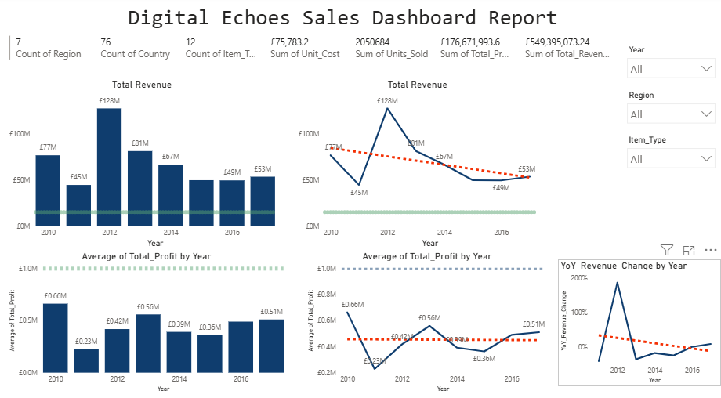
Key
Target set ….
Trend …….

Slide 7
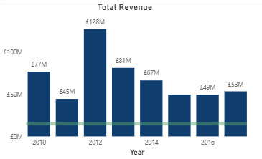
KPI 1: Total Revenue made annually
SUMMARY REPORT
(Fig 1) Show the revenue for digital echoes from the period of 2010 to 2017.
The highest total revenue can be seen in 2012 of £128M.
The lowest total revenue can be seen in 2012 of £45M.
The sales targets has been set for
£15, 000000 which has been exceeded every year.
(Fig 1)

Slide 8
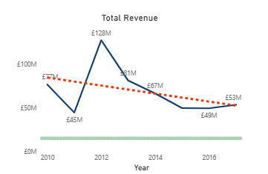
KPI 1: Total Revenue made annually
SUMMARY REPORT
(Fig 2) Show the revenue the trend in total sales of digital echoes from the period of 2010 to 2017.
The largest increase in sales occurred from 2011 to 2012 with an 183% Increase
Overall revenue change over the period of 2010 to 2017 is 10.79%
(Fig 2)

Slide 9
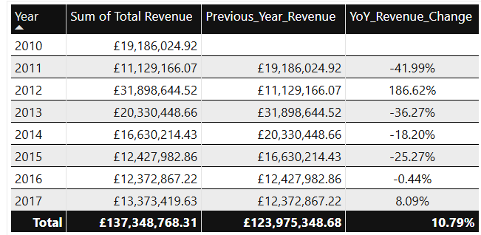
KPI 1: Total Revenue made annually
SUMMARY REPORT
(Tab 1) Show the percentage change in revenue from 2010 to 2017 for digital echoes.
Despite the significant increase in 2011 to 2012, this trend was not sustained from 2013 to 2016.
(Tab 1) shows a positive increase in revenue from 2016 to 2017 of 8.1% which is notable.
(Tab 1)

Slide 10
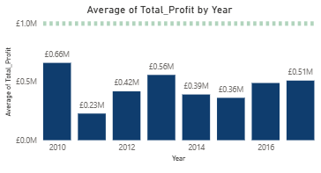
KPI 2 Average profits made annually
SUMMARY REPORT
(Fig 3) Compares the average profit of digital echoes from 2010 to 2017.
Overall annual profit targets of
£1 M was not met from the time period analysed.
2010 had the highest average profit of £0.66M in comparison to 2011 that had the lowest average profit of £0.23M.
(Fig 3)

Slide 11
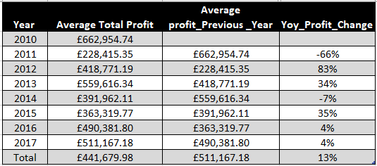
KPI 2 Average profits made annually
SUMMARY REPORT
(Tab 2) Compares the percentage change in average profit of digital echoes from 2010 to 2017.
Average profits have increased consistently
from 2011 to 2012 by 83% ,
and 2012 to 2013 by 34%.
We can also see an increase in average profits from 2015 to 2016 by 35%.
and from 2016 to 2017 by 4%
(Tab 2)

Slide 12
CONCLUSION
In conclusion total annual sales targets of £15M was exceeded from 2010 to 2017 .
However the overall trend on annual revenue showed a decline in the period of 2013 to 2016.
A significant a typical positive change can be seen in total revenue from 2010 to 2011 of 186%.
Annual profit targets of £1M were not meet in the time frame of 2010 to 2017.
Steady increase in profits can be seen from the year 2011 to 2012 of 83%, also in 2015 to 2016 of 35% and from 2016 to 2017 there is a further increase of 4%.

Slide 13
RECOMMENDATION
Annual sales bench marks need to be reviewed, are these robust and ambitious and reflective of companies overall aims.
Decline in profits from time period of 2013 to 2016 will require a review of operational efficiencies with considerations to
Cost control measures across regions
Review Supply chain management to control costs
Review operational and marketing strategies
Further areas to analyse are
Market segmentation and trends in customer churn
Build predictive models to support business decisions
Cross functional collaboration with advertising , marketing and finance to support informed decisions

Slide 14
END

